Slide 1
SECURING ATM TRANSACTION WITH FACIAL RECOGNITION BASED VERIFICATION SYSTEM
TEAM MEMBERS
BARATH S (922221104007)
DHANASEKARAN N (922221104012)
KUMARASAN T (922221104701)
GUIDE : MR.AYYAPPARAJA K ,AP/CSE

Slide 2
ABSTRACT
ATM or Automated Teller Machines are widely used by people nowadays. Performing cash withdrawal transaction with ATM is increasing day by day. The existing conventional ATM is vulnerable to crimes because of the rapid technology development. A secure and efficient ATM is needed to increase the overall experience, usability, and convenience of the transaction at the ATM. Specifically, the goal of this project is to give a computer vision method to solve the security risk associated with accessing ATM machines. This project proposes an automatic teller machine security model that uses electronic facial recognition using Deep Convolutional Neural Network. Face Verification Clickbait Link will be generated and sent to bank account holder to verify the identity of unauthorized user through some dedicated artificial intelligent agents, for remote certification.

Slide 3
INTRODUCTION
ATM transactions are an essential part of modern banking, but traditional authentication methods like PIN codes and ATM cards are highly vulnerable to theft, skimming, and fraud. Criminals stolen cards and leaked PINs to gain unauthorized access, leading to financial losses. Face recognition is a method of identifying or verifying the identity of an individual using their face. Due to its non-intrusive and natural characteristics, face recognition has been the prominent biometric technique for identity authentication. The blend of deep learning models with facial recognition technology has enhanced the service in terms of speed and accuracy. It holds the power to improve the accuracy of facial recognition systems by using trained Convolutional Neural Networks (CNNs).

Slide 4
OBJECTIVES
To enhance ATM security using advanced facial recognition technology.
Eliminate unauthorized access through biometric verification.
Provide a contactless and convenient authentication method.
To reduce ATM fraud and card skimming incidents.
Integrate AI-based facial detection for real-time identity validation.
To ensure user privacy and data protection during transactions.

Slide 5
LITERATURE SURVEYS
Title 1 : Secure Biometric Verification in the Presence of Malicious Adversaries.
Author : Kamela Al-Mannai,
Year : 2024
Objective :
The research focuses on enhancing the robustness of biometric systems—such as fingerprint, facial recognition, and iris-based authentication—against spoofing attempts, template theft, and adversarial machine learning attacks. The authors propose a multi-layered defense framework that integrates liveness detection, adversarial training, and secure template storage to strengthen biometric verification processes.
Title 2 :Liveness Detection in CV:Transformed-Based Self-Supervised Learning for Face Anti-Spoofing.
Author: Arman Keresh and Pakizar Shamoi
Year : 2024
Objective :
This research addresses the growing threat of facial spoofing attacks—such as printed photos, replay videos, and 3D masks—on biometric systems, especially those used in smartphones, access control, and secure authentication scenarios.

Slide 6
Title 3 : Smart Transaction through an ATM Machine using Face Recognition. Author : K. Madhavi, N. Divya, and K. Rajeswari. Year : 2020 Objective : This approach addresses the limitations of physical cards and passwords, which are prone to loss theft, and fraud. The system leverages computer vision and machine learning technologies to authenticate users based on their facial features, thereby enabling secure and contactless ATM transactions. Title 4 : Face Biometric Authentication System for ATM Using Deep Learning. Author : A. Dhananjay, M. Meghana, and R. Sangeetha Year : 2021 Objective : The study is to replace conventional ATM card and PIN-based systems with a face-based on this biometric verification system to prevent fraudulent activities and enhance user convenience. This face the authentication model aims to make transactions safer and more accessible, particularly in the context of a increasing digital banking and financial security threats.

Slide 7
EXISTING SYSTEM
Existing ATM authentication method is the use of password-PINs and OTP.
QR cash withdrawals were enabled so customers could ditch their ATM cards and simply scan a QR-code on ATMs using the QR app to withdraw cash.
ATM security system architecture that incorporates both the finger print and GSM technology into the existing PIN-based authentication process.
Merits
High Security is the eliminates card fraud & PIN hacking.
It’s Real-Time Authentication Fast & AI-powered verification.
Users can be User-Friendly then No need for cards or PINs.
Authenticate the system provide when the verification Sends alerts on suspicious access.
Demerits
High Initial Setup Cost requires AI-based ATM infrastructure.
Privacy Concerns that can Users may be hesitant to share facial data.
Lighting Issues for the Poor lighting or obstructions can affect records.

Slide 8
PROPOSED SYSTEM
Face Detection and Recognition: This module captures the image of the user's face and applies Convolutional Neural Network (CNN) algorithms to detect and recognize the user's face.
Face Verification Link Generation: Once the user's identity is confirmed, this module generates a face verification link and sends it to the authorized account holder's mobile number. The link contains the face image of the user captured at the time of transaction and is used for verification purposes.
Mobile based Unauthorized Verification: This module is responsible for receiving the face verification link on the authorized account holder's mobile number and verifying the link to confirm the user's identity. The link is accessible only for a limited time, and the system sends an alert to the user if the link is not accessed within the specified time.

Slide 9
It’s MERITS
The advantages can be found as that the face-id is unique for everybody, it cannot be used by anybody other than the user.
It can be used to reduce fraudulent attempts.
To prevent theft and other criminal activities.
Secure facial authentication platform that users can trust
Provide safe and secure lifestyle infrastructure
Prevent unauthorized access using Face verification Link.
Fast and Accurate Prediction

Slide 10

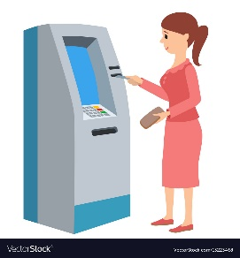


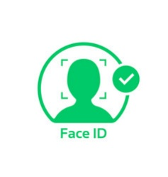


SYSTEM ARCHITECTURE
Dispatch to Account Holder
Bank Server
Generate ATM ID
Captured Face
Enrol Account Holder Face
Account Creation
Login
Face Verification
AH
Transaction
Bank
Unknown Face Forwarder Link
Account Holder
Bank Security Protocol

Slide 11
SYSTEM AND HARDWARE REQUIREMENTS
SOFTWARE REQUIREMENTS
Operating System: Windows 10 or higher.
Python: Computer vision . OpenCV for the image and video data in ATM camera.
Flask: For creating APIs or a lightweight dashboard to monitor transactions.
MySQL: For more scalable solutions to store account and transaction data.
Python Packages: Numpy, Pandas, Matplotlib, and Scikit-learn
Web Server: Apache Web Server (in WampServer)
HARDWARE REQUIREMENTS
Processor : Intel i5 ,8GB RAM and 256GB Storage
Camera : HD Webcam
Internet : Required for mobile linking

Slide 12
MODULE DESCRIPTION
User Interface Modules
Face Recognition Modules
Face Identification Modules
Face Verification Link Generation Modules
Face verification Process Modules
6. Notification Process Modules

Slide 13
1.User Interface Modules
1.1 ATM System
Cardholder Interaction
Upon inserting their ATM card into the interface, users kick-start transactions. The system promptly reads the card details to facilitate seamless transaction processing.
Facial Recognition
Simultaneously, the system employs advanced facial recognition technology to capture the user's face. This captured image is then meticulously compared with the pre-trained face model stored in the system's database.
Face Verification Link
For added security, the system generates a Face Verification Link. This link is promptly dispatched to the mobile number linked to the card account, ensuring an extra layer of identity confirmation.

Slide 14
1.2. ATM User/Account Holder Interaction
Cash Withdrawal
When an ATM user seeks to withdraw cash, they simply insert their card, initiating a streamlined process. The system then verifies the user through multi-factor authentication.
Secure Login
Bank employees gain access to the system through a secure login process, ensuring that only authorized personnel can manage the ATM functionalities.
Account Management
Equipped with secure access, bank employees can seamlessly create new bank accounts, streamlining the on boarding process for customers.
Generate ATM ID, Dispatch to Account Holder
Upon the creation of a new account, the system generates a unique ATM ID. This ID is dispatched to the account holder, completing the account creation process

Slide 15
2.Face Recognition Modules
Dataset Creation: Account Holder Face by Recording Live Video
The process begins with actively creating a comprehensive dataset by recording a live video of the account holder's face.
Face Detection
This module identifies potential face regions within the pre-processed images. RPN excels at proposing regions likely to contain facial features, laying the groundwork for subsequent processing. It streamlines the computational effort by focusing on regions of interest, enhancing efficiency in face recognition.
Face Feature Extraction
This module focuses on extracting relevant features from the detected face regions using GLCM captures statistical information about pixel intensity relationships, offering a rich set of features for subsequent classification. It serves as a robust method for characterizing facial textures and patterns. An using CNN concern of the system allocation when the problem to solve the module in face authentication process.

Slide 16
3.Face Identification Modules
ATM Captures User's Face
The Face Identification module commences with the ATM employing integrated cameras or sensors to capture a live image of the user's face during a transaction. This process is crucial for obtaining a real-time representation of the user's facial features, capturing nuances such as facial expressions, contours, and unique identifiers.
Extract Features
Following the capture of the facial image, the system moves to the extraction phase where it identifies and isolates key features from the user's face. These features include but are not limited to facial landmarks, texture patterns, and distinctive attributes that collectively contribute to a comprehensive and unique facial profile.

Slide 17
4.Face Verification Link Generator
Generate Face Verification Link
In response to non-matching faces, the system promptly generates a Face Verification Link. This link is designed to serve as a secure and temporary reference for the user's facial profile, introducing an extra layer of security for subsequent verification steps.
Link Transmission to User's Mobile Number
The Face Verification Link is swiftly transmitted to the user's mobile number, enhancing security by sending the link to the device associated with the authorized account holder. This proactive step ensures that the user is promptly informed and involved in the verification process.

Slide 18
5.Face Verification Process
Link Access and View User
The authorized account holder receives the Face Verification Link on their mobile device. By clicking the link, they are directed to a secure page displaying the captured image of the user at the ATM.
Enter Amount and PIN
Upon approving the user, the account holder proceeds to enter the desired withdrawal amount and their unique Personal Identification Number (PIN). This step confirms their intention to proceed with the transaction.
Confirmation and Money Dispensation
With the entered amount and PIN, the account holder confirms the transaction. The ATM machine, recognizing the approved user, dispenses the requested amount of money.

Slide 19
6.Notification Modules
The Notification Module is triggered by various events within the system. These events could include successful transactions, security alerts, account activity updates, or any other significant occurrences requiring user attention.
The module supports different types of notifications, such as in-app alerts, SMS messages, or email notifications. Users are notified in real-time about successful or unsuccessful transactions.
Transaction alerts include details such as transaction amount, date, time, and the location of the transaction. These alerts may include unauthorized access attempts, unusual spending patterns, or any activity that deviates from normal user behaviour.

Slide 20
IMPLEMENTATION DETAILS
1. Face Registration – Users scan their face at the bank/ATM. FaceNet extracts and stores facial features securely.
2. Face Detection – When a user approaches the ATM, OpenCV captures and detects their face using the camera.
3. Authentication – FaceNet + TCN compare the live face with stored data. If it matches, the user gets access.
4. Fraud Detection – If an unauthorized face is detected, an unmatched issue to perform when is sent via SMS/Email to the user.
5. Verification Link: If the user's face is successfully identified, the system will send a verification link to the user's registered mobile number.

Slide 21
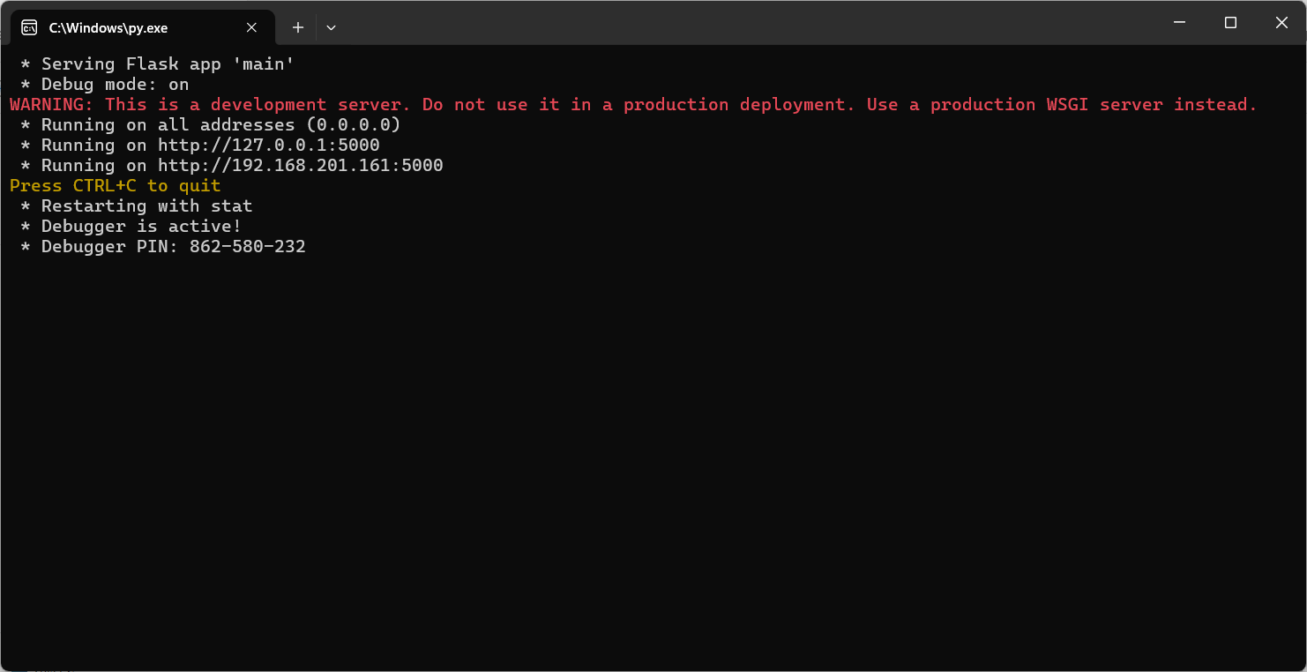
Result and Analysis:

Slide 22
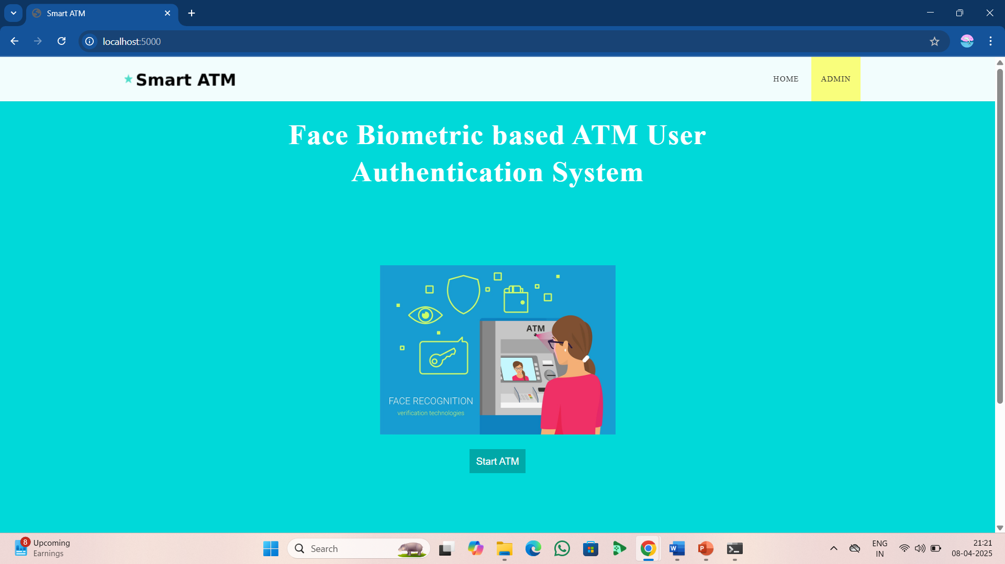
-Web page to start from the Face ATM.

Slide 23
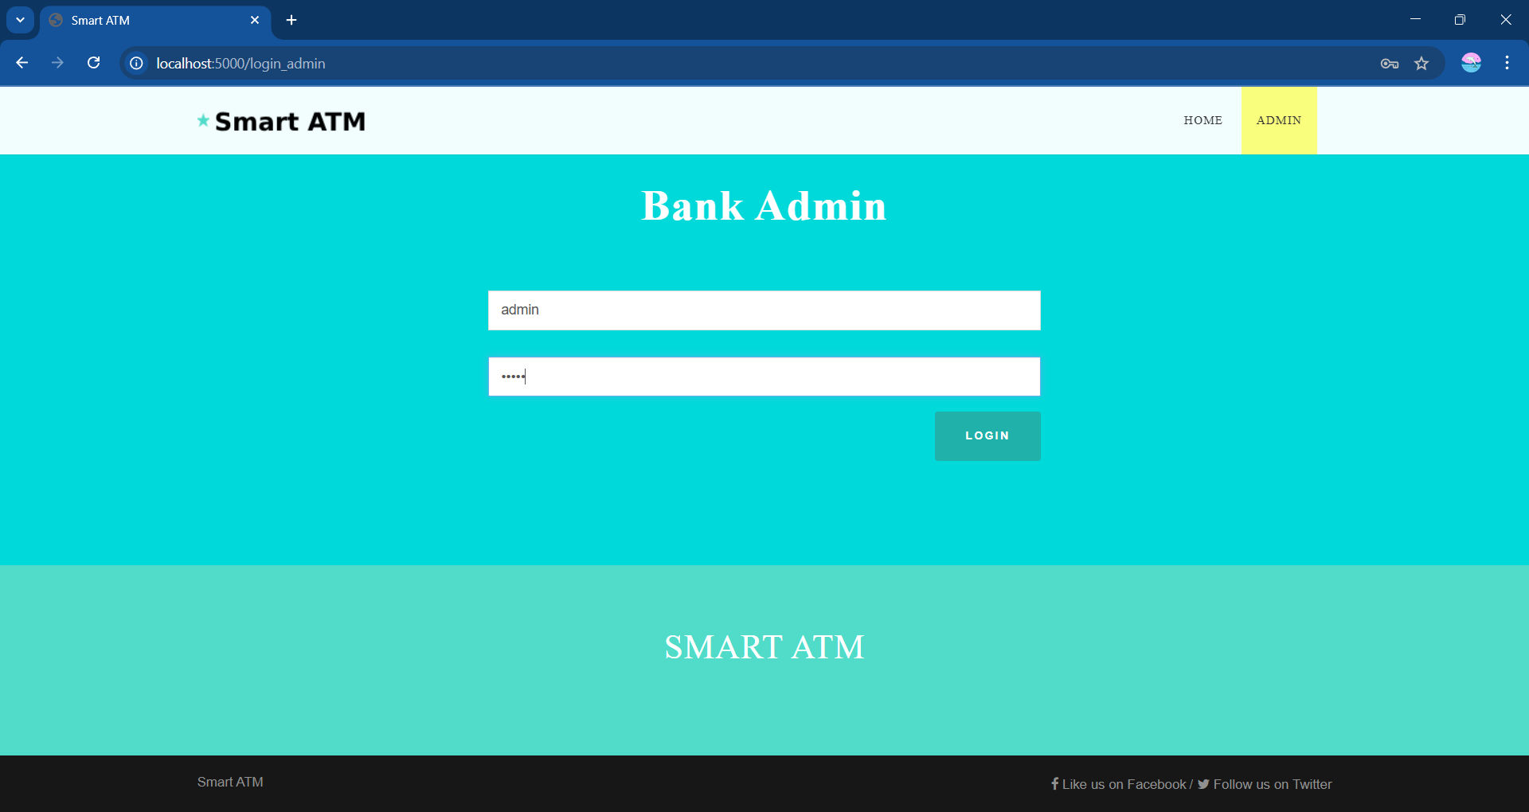
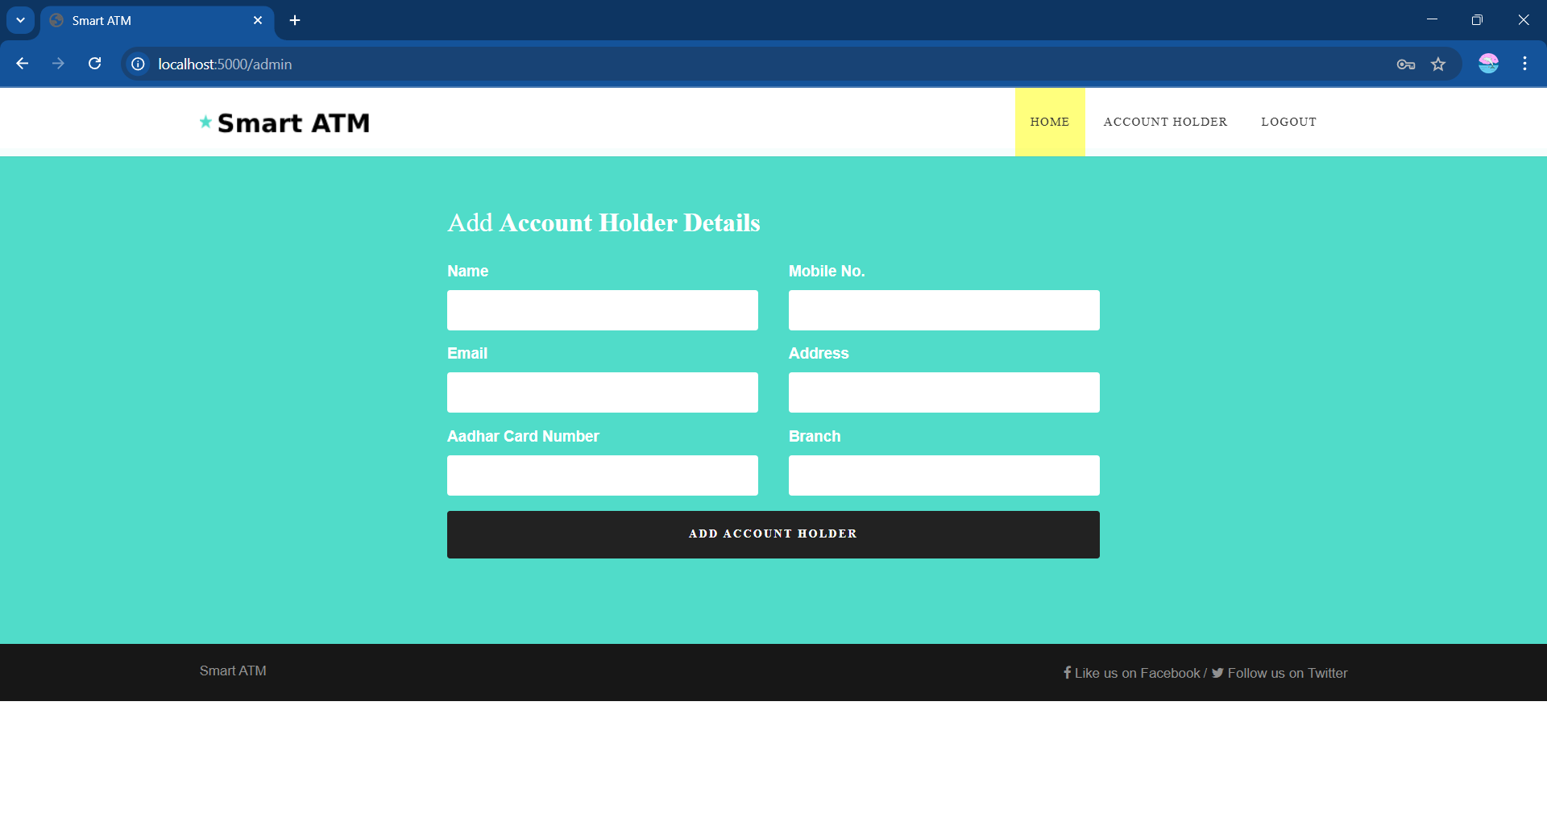
- First to user can registered to our details from the Admin to user name and passward to registration. when the Account Holder detail block to next.

Slide 24
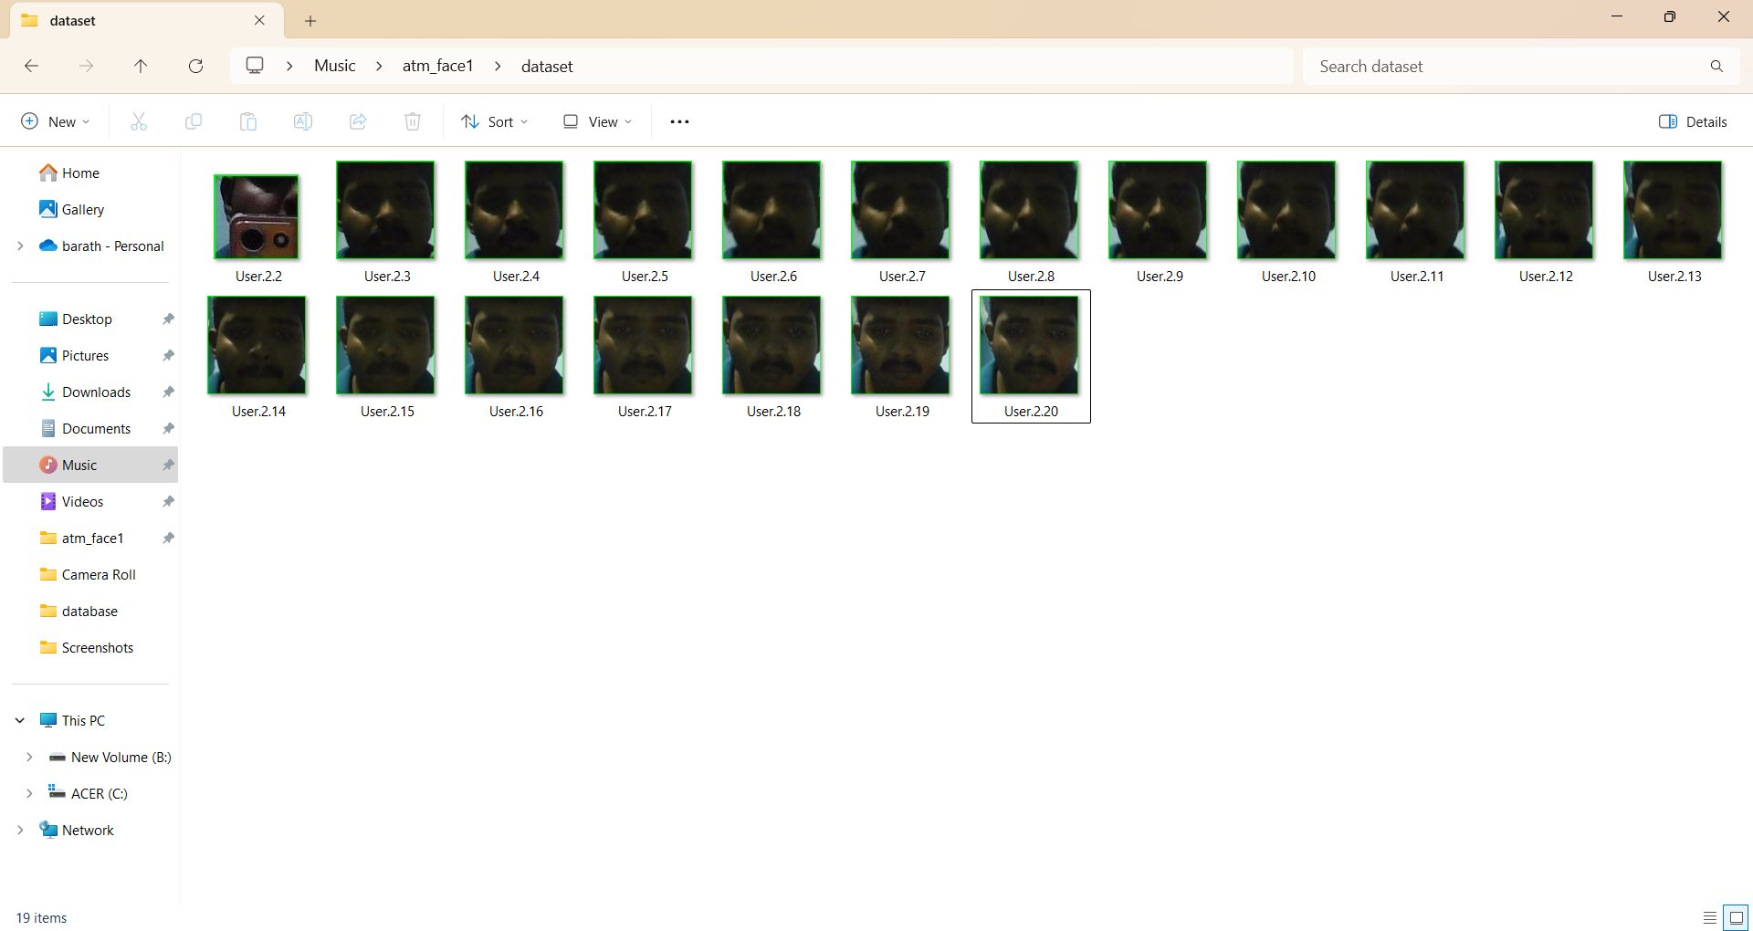
-Next Capture the face to user, then stored databases in files

Slide 25
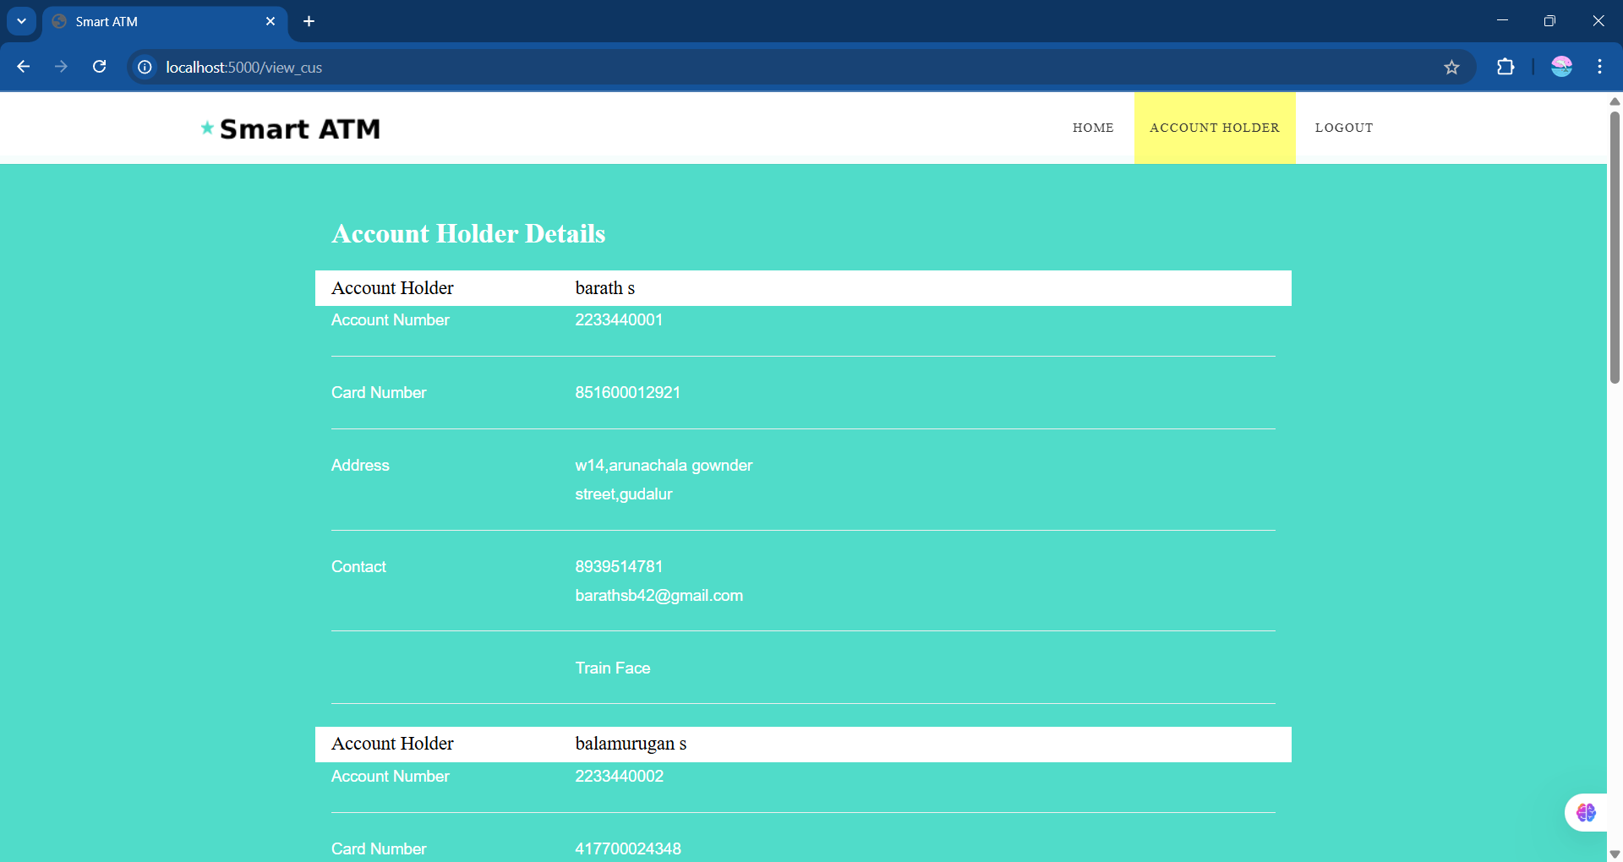
-Then get the account number to copy when we have put the insert ATM card no. page.

Slide 26
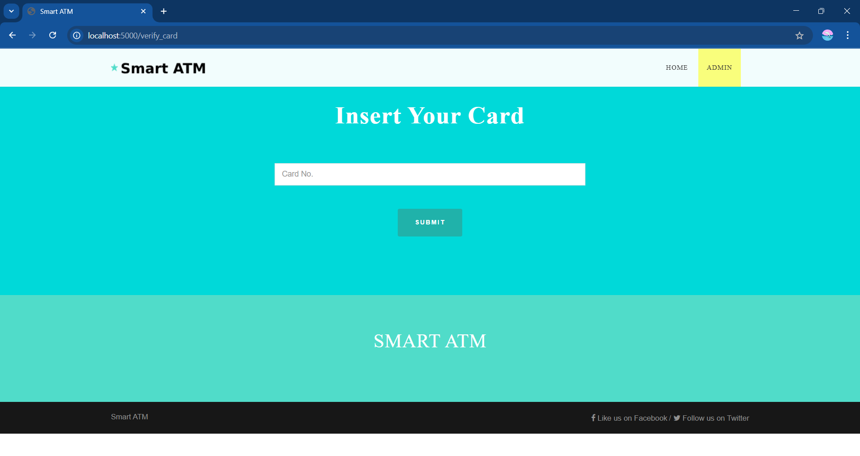
- Then stored databases of the captured image and then home to start of the ATM. When the put to pin numbers.

Slide 27
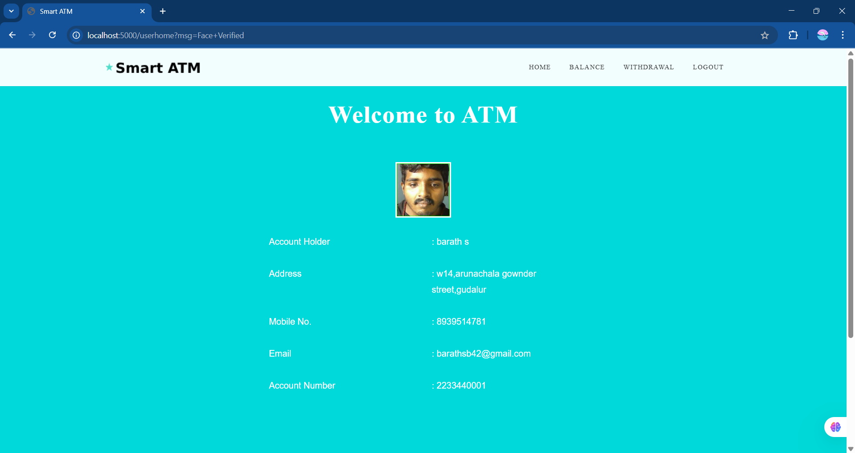
-Verify the face that card no. to account holder when the used for withdraw or balance check.

Slide 28
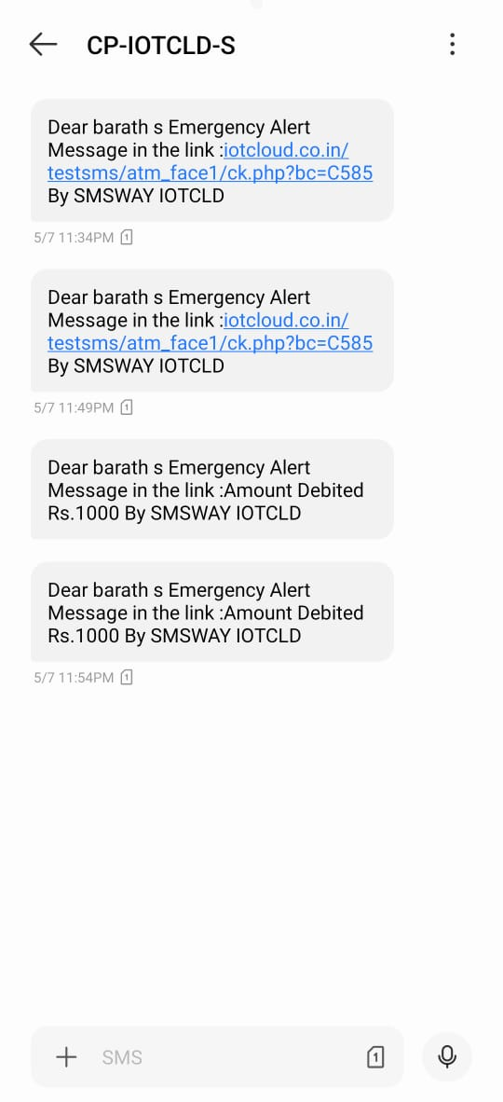
-Otherwise the unmatched face to found the ATM captured face for then notification send to account holder when the accept for request to withdraw the accounter give the amount.

Slide 29
CONCLUSION
The Face ATM project represents a significant leap in the way financial transactions can be secured and authenticated. By leveraging facial recognition technology, this system ensures enhanced security, reducing the chances of fraud and unauthorized access. Additionally, it offers convenience for users by enabling seamless, contactless transactions. The integration of this system into ATM machines could revolutionize banking services, making them more accessible, faster, and user-friendly. As technology continues to evolve, such innovations have the potential to reshape the future of banking and financial services, offering more efficient and secure ways to interact with money. Facial recognition-based ATM verification is a secure, modern, and user friendly approach to safeguard financial transactions.

Slide 30
FUTURE ENHANCEMENT
1. Implementing Liveness Detection
To prevent spoofing attacks using photos or videos by verifying real-time presence.
2. 3D Camera Integration Upgrading
To 3D facial recognition for improved accuracy and depth-based detection.
3. Full Integration with Mobile Banking Apps
Allow users to manage ATM access, view logs, or enable/disable facial login via their phones.
4. Robust Recognition in Challenging Environments
Improve accuracy in low light, varying angles, and when users wear masks or glasses using advanced deep learning models.

Slide 31
REFERENCES
1.Jain, A. K., Ross, A., & Prabhakar, S. (2004). An introduction to biometric recognition. IEEE Transactions on Circuits and Systems for Video Technology.
2. Li, S. Z., & Jain, A. K. (Eds.). (2011). Handbook of Face Recognition. Springer.
3. Turk, M., & Pentland, A. Eigenfaces for recognition. Journal of Cognitive Neuroscience.
4. Viola, P., & Jones, M. Rapid object detection using a boosted cascade of simple features. CVPR.
5. Parkhi, O. M., Vedaldi, A., & Zisserman, A. (2015). Deep face recognition. BMVC.
6. Schroff, F., Kalenichenko, D., & Philbin, J. (2015). FaceNet: A unified embedding for face recognition and clustering. CVPR.
7. Taigman, Y., Yang, M., Ranzato, M. A., & Wolf, L. (2014). DeepFace: Closing the gap to human-level performance in face verification. CVPR.

